Slide 1
Descriptive Cataloging
Using RDA
Module 7
Relationships in RDA
Authority Control
Cooperative and Instructional Programs Division
Library of Congress
2014

Slide 2
Acknowledgements
This course is the result of collaboration between
  Tim Carlton, Cooperative and Instructional Programs Division, Library of Congress
  Ingrid Hsieh-Yee, Ph. D., Dept. of Library & Information Science, Catholic University of America
It has been adapted from training developed by Barbara Tillett and Judith Kuhagen, Library of Congress Policy and Standards Division, and other Library of Congress staff
COIN gratefully acknowledges PSD’s permission to adapt the material for the present purpose
Notes:
Pedagogical notes for instructors:
COMPREHENSIVENESS: This material was developed for a 3-hour instructor-led course. There is a LOT of material in this module. Each instructor should determine which portions need to be covered in more or less detail. It is not intended that every slide be instructed in detail.
It is assumed that the audience has no previous knowledge of descriptive cataloging, and that they have a basic knowledge of FRBR. The level of detail is at the ‘conceptual’ level. Accordingly, the instruction is designed as an overview, and does not necessarily drill to a granular level of detail.
In places where LC policy differs from RDA as written, emphasis will be placed on LC policy.
It is suggested that you open the RDA Toolkit to look at selective instructions, when the slides do not provide the desired detail.

Slide 3
About This Material
This training material has been created for a primary audience of Library of Congress staff.
  Other audiences are welcome to adapt and utilize it as they see fit. However, it should be understood that it reflects LC policies, and should not be interpreted to either prohibit or require specific practices for other libraries or organizations.

Slide 4
Relationships in RDA

Slide 5
Learning Objectives
Basics of RDA Relationships
Core Relationships: Group 1 – Group 2
Core Relationships: Group 1 – Group 1
Core Relationships: Group 2 – Group 2
Notes:
[animated upon click]
[Be sure to note the point of the last three bullets: we will focus on the core relationship]

Slide 6
Unit 1: Basics of RDA Relationships
The What and the Why
The Who and the How
Relationships Between …
Where are the Instructions?
Relationship Designators
Methods of Expressing Relationships

Slide 7
The What and the Why
What are relationships?
  Connections between entities
    Author/novel; composer/music; serial title/title change; work/expression; person/family
Why are relationships important?
  Help users find what they want!
Notes:
WHAT:
The entities that we identify when cataloging -- people, corporate bodies, families, and resources -- are associated with one another. These are relationships.
WHY:
We need to reflect important relationships in our catalogs and resource discovery systems, in order to show users the pathways to related materials.

Slide 8
The Who and the How
Who are the related entities?
  WEMI ; Person/Family/Corporate Body
  Identified by
    authorized access point
    identifier
    URI
    bibliographic description
How are they related?
  Role or function
  Denoted by
    Relationship designator
    Other indications (e.g., MARC tag)
Notes:
We will discuss two aspects of Relationships:
Who are the related entities? Entities can be identified by an authorized access point; or by an identifier such as an ISSN or an ISBN; or by URI (universal resource identifier); or by a description (note).
How they are related? The relationship is indicated by a relationship designator (discussed on slides 11-13) or another indication (e.g., MARC coding). For example, a term may be used to indicate what role a person, corporate body, or family plays with respect to a particular work, expression, manifestation, or item.
We will focus on LC Core relationships.

Slide 9
Relationships Between …
Resources and associated persons, families, and corporate bodies
  Group 1 – Group 2
  WEMI – P/F/CB
Resources and other resources
  Group 1 – Group 1
  WEMI - WEMI
Persons, families, corporate bodies and other persons, families, corporate bodies
  Group 2 – Group 2
  P/F/CB – P/F/CB
9
Notes:
9
We will discuss three types of relationships.

Slide 10
Where are the Instructions?
Between resources and associated persons/families/corporate bodies
  Chapters 18-22; Appendix I
  Used in bibliographic records
Between resources
  Chapters 24-28; Appendix J
  Used in bibliographic and authority records
Between persons/families/corporate bodies
  Chapters 29-32, Appendix K
  Used in authority records
Notes:
The Appendices provide the controlled terms for relationship designators.
RDA 18-22/Appendix I: For example, the designator “author” expresses the relationship between the creator of a primarily textual work and the work itself.
RDA 24-28/Appendix J: For example, the designator “adaptation” may be used to express a relationship between a work “based on” a work and the original work.
RDA 29-32/Appendix K: For example, the designator “alternate identity” expresses a relationship between a pseudonymous or other identity assumed by a person and the person.

Slide 11
Relationship Designators
They ‘designate relationships’ (duh!)
Appendices I, J, and K are ‘open’ lists
Only a few designators are core
  That’s what we’ll focus on in this module
  Otherwise, cataloger judgment
If you use them, use them appropriately
Consult the PCC Guidelines for the Application of Relationship Designators in Bibliographic Records
11
Notes:
11
Relationship designators are terms used to describe relationships among resources, persons, families, and corporate bodies.
If a needed term is missing, catalogers may propose new relationship designators.
Be careful to apply relationship designators in accordance with their definitions.
[link opens the guidelines document]
PCC Guidelines state that, generally, the use of relationship designators is ‘strongly encouraged’ but not required.

Slide 12
Relationship Designators –
PCC Guidelines
include a relationship designator for all creators, whether coded 1XX or 7XX
use designators from RDA appendices
prefer a specific term to a general one
if the nature of the relationship cannot be determined, do not assign a designator
if multiple designators are appropriate because the same entity has multiple roles, prefer to use repeated $e
    100 1 Stone, Melicent, $e author, $e illustrator
12
Notes:
12
Emphasized here are the Appendix I designators for relationships between resources and the associated Persons/Families/Corporate Bodies.
Other guidelines apply to Appendix J and Appendix K designators.

Slide 13
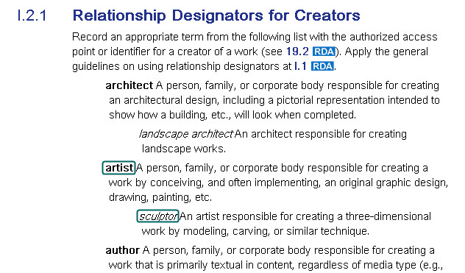
Relationship Designators –
Example from RDA Appendix I
13
Notes:
13
Appendix I lists the “relationship designators” or roles played by the persons, families, and corporate bodies associated with Works, Expressions, Manifestations, and Items.
I.2.1, shown here, lists the Relationship Designators for Creators.
Note the highlighted generic and specific designators, each defined for proper usage

Slide 14
Methods of Expressing Relationships
Authorized access point
  110 2# $a Society of Linguists, $e author
Structured description
  776 08 $i Also issued as: $t Health statistics
Unstructured description
  500 ## $a Translation of the author’s novel Digital fortress
Notes:
In the first example, the relationship between creator to a work is expressed in subfield $e author in the authorized access point
In the second example, a structured description uses a formatted note such as a linking field of an equivalent manifestation relationship (shown with the 776 field). Another example of a structured description could be a 5XX note with ISBD punctuation.
In the third example, an unstructured description uses an unformatted note, such as a 500 general note (as shown).
We will see additional examples on later slides.

Slide 15
Methods of Expressing Relationships
-- MARC coding
$e of 100-110 and 700-710
$j of 111 and 711
$i of 700-730
$i of 76X-78X linking entry fields
MARC 21 tags and indicators
  780 “continues”; 785 “continued by”
  264 fields (publisher, distributor, etc.)
Notes:
[Instructor: be careful not to belabor these next few slides or suggest that students memorize this; they are intended as a reference, and later examples will help clarify]
Use $e designator in 100/110 and 700/710 to show relationships between resources and their ‘producers’;
Use $j designator in 111 and 711 to show these same types of relationships (because $e is used in X11 fields to denote subordinate units for conferences);
Use $i designator in 700-730 to give a term phrase from appendix J, such as “Translation of,” preceding the authorized access point for the related resource;
Use $i designator in 76X-78X linking entry fields to show relationships between resources.
Some relationships are denoted by the MARC tag and indicators.

Slide 16
Methods of Expressing Relationships
-- Form of 700/730 Access Points
When citing another resource in 700-730 authorized access points:
  Use the form found in the Authority Record

Slide 17
Methods of Expressing Relationships
-- Form of 760-787 Linking Fields
  When citing another resource in 760-787 linking fields (for example, a reproduction)
  Copy/paste what is in the existing bibliographic record for that resource and adjust the subfield coding as appropriate

Slide 18
Unit 2: Core Relationships:
Group 1 – Group 2
Relationships that are Expressed in Bibliographic Records
Relationships to Works
Relationships to Expressions
Relationships to Manifestations
Relationships to Items
Summary of Core Relationships
18
Notes:
18

Slide 19
Relationships that are Expressed in Bibliographic Records
Creators and others associated with works (RDA 19)
Contributors associated with expressions (RDA 20)
Manufacturers, publishers, distributors associated with manifestations (RDA 21)
Owners, annotator, autographer, etc. associated with items (RDA 22)
Appendix I for Relationship Designators
Notes:
19
[Instructor: Reiterate that the terms ‘creator’ and ‘contributor’ have very distinct meanings.]

Slide 20
Relationships to Works –
Creators
“a person, family, or corporate body responsible for the creation of a work”
involved at the work level
  author
  compiler (if a creator)
  composer
  filmmaker
  interviewer
  programmer
  [and others … ]

Slide 21
Relationships to Works –
Creators
RDA and LC-PCC PS 19.2
Core relationship
  creator having principal responsibility named first
  If principal responsibility is not indicated, first-named
  authorized access point in 1XX field
If multiple, apply cataloger judgment
  authorized access point in 7XX field(s)
Relationship designators from I.2.1
  $e of 1XX/7XX
Notes:
LC practice/PCC practice for Core element when there is more than one creator: After satisfying the RDA core requirement, catalogers may provide additional authorized access points according to cataloger’s judgment.

Slide 22
Relationships to Works –
Creators -- Examples
110 $a Society of Linguists, $e author.
710 $a Linguists International, $e author.
100 $a Glass, Philip, $e composer.
110 $a Virginia, $e enacting jurisdiction.
Notes:
In the first example, two creators are shown, in the 110 and 710. If a creator is part of the authorized access point for the work, record in 100 $e of the bibliographic record a relationship designator from appendix I to show the type of relationship between the creator and the work. If there is more than one creator, and you provide a 7XX for the additional creator(s), the appropriate relationship designator should also be assigned in the 7XX $e.
(note that “author” does not necessarily equate to the obsolete AACR2 concept of “main entry”).
The other examples show use of other relationship designators for creators from I.2.1.

Slide 23
Relationships to Works –
Other Entities -- Examples
19.3 Others associated with works
Relationship designators from I.2.2
710 $a ABC Institute, $e sponsoring body.
710 $a California Academy of Sciences, $e issuing body.
23
Notes:
23
There are roles other than creator associated with works; those relationships are covered in RDA 19.3. “Other person, family or corporate body associated with a work.”
Show here are two examples (from I.2.2) of relationship designators we might use on serial records:
issuing body: A person, family or corporate body issuing the work, such as an official organ of the body.
sponsoring body: A person, family, or corporate body sponsoring some aspect of the work, e.g., funding research, sponsoring an event.

Slide 24
Relationships to Expressions –
Contributors
“a person, family, or corporate body contributing to an expression”
involved at the expression level
  translator
  editor of compilations
  performer
  illustrator
  arranger of music
  compiler (if not a creator)
Notes:
24

Slide 25
Relationships to Expressions –
Contributors
RDA and LC-PCC PS 20.2
Core relationships
  LC Practice
    first illustrator of resource intended for children
    if multiple, apply cataloger judgment
  PCC Practice
    if considered important for identification
Authorized access point in 7XX field(s)
Relationship designators from I.3
Notes:
Other contributor relationships are not core in RDA; record other contributors if they are considered important for identification.

Slide 26
Relationships to Expressions –
Contributors -- Example
100 1# $a Wood, Audrey, $e author.
245 14 $a The napping house / $c Audrey Wood ; illustrated by Don Wood.
700 1# $a Wood, Don, $e illustrator.
Notes:
  LC policy: provide AAP for the contributor and add $e illustrator
  2nd statement of responsibility is not core but is helpful
Notes:
26
LC-PCC PS for I.3.1: “When providing an authorized access point for an illustrator in the bibliographic record for a resource intended for children, include the appendix I designator "illustrator" in MARC 700 subfield $e.”
This is an example of the one required expression level relationship for LC.
This example shows the contributor, Don Wood, with subfield $e “illustrator” to represent the relationship to the expression that is embodied in the manifestation that we are describing. Both the access point and the relationship designator are required for LC practice.
However, that access point doesn’t need to be justified by including the 2nd statement of responsibility as shown in the example; that second statement of responsibility is not “core” in RDA, so may be omitted, while still keeping the 700 field.

Slide 27
Relationships to Expressions –
Contributors -- Example
100 1# $a Lindgren, Astrid, $d 1907-2002,
$e author.
240 10 $a Pippi Långstrump. $l English
245 10 $a Pippi Longstocking / $c Astrid
Lindgren ; translated by Tiina Nunnally.
700 1# $a Nunnally, Tiina, $d 1952- $e
translator.
Notes:
  700 and use of relationship designator translator are both ‘cataloger judgment’
  2nd statement of responsibility is not core but is helpful
Notes:
27
This example shows a common situation: recording an access point for a translator.
Neither the access point nor the relationship designator are core; but both are helpful. You can even provide the access point, without the relationship designator.
Remember that recording the second statement of responsibility is also not core.

Slide 28
Relationships to Expressions –
Contributors -- Example
245 $a Favorite American music / $c performed by the Baltimore Symphony Orchestra with Marin Alsop conducting.
505 $a … [various pieces performed]
710 $a Baltimore Symphony Orchestra, $e
performer.
700 $a Alsop, Marin, $e conductor.*
* prefer a specific term to a general one if it can be easily determined
Notes:
This slide shows an example with two contributors to the expression.
Both access points are optional, but helpful.

Slide 29
Relationships to Manifestations
Persons/families/corporate bodies involved at the manifestation level
  producer
  publisher (broadcaster, etc.)
  manufacturer (printer, engraver, etc.)
  distributor (film distributor, etc.)
Notes:
29

Slide 30
Relationships to Manifestations
RDA Chapter 21
Record “if considered important for access”
Relationship designators from I.4
  Very few listed
  Producer, publisher, manufacturer, distributor are separate RDA elements
30
Notes:
30
30
Note that these chapters relate to recording relationships for these entities (i.e., as access points). Chapter 2 provides instruction as to whether (and how) to record them as manifestation elements.
Producers, publishers, distributors, manufacturers are listed in chapter 21 as types of relationships but these terms are not included as relationship designators in Appendix I.4 because they are separate elements in RDA and have dedicated MARC fields. Importantly, this should NOT be interpreted to suggest that the access points themselves are inappropriate; that is a matter of cataloger judgment.

Slide 31
Relationships to Manifestations -- Examples
264 #1 $a Bethesda : $b NIH, $c 2008.
710 2# $a National Institutes of Health (U.S.), $e broadcaster.
264 #1 $a St. Paul : $b West Publishing Company, $c 2011-
710 2# $a West Publishing Company, $e publisher.*
* “publisher” is not found in Appendix I.4 but may be used as a relationship designator, per PCC Guideline 4
Notes:
In the first example:
Even without the relationship designator “broadcaster” in 710 $e, the second indicator of field 264 #1 indicates that NIH is an entity involved in “publishing.” The inclusion of “broadcaster” further clarifies the kind of publishing activity.
In the second example, because “publisher” is an RDA element name, it is not listed in I.4.2. However, PCC Guideline 4 allows catalogers to assign an RDA element name as a relationship designator (e.g., "publisher“, per 21.3) if it will most appropriately express the relationship.

Slide 32
Relationships to Items
Persons/families/ corporate bodies involved at the item level
  owner
  custodian
  curator
RDA Chapter 22
Record “if considered important for access”
Relationship designators from I.5
Notes:
Remember that this has to be a relationship to only one instance of the manifestation (for example -- one copy, but not all copies, of an edition of a book)

Slide 33
Relationships to Items –
Examples
500 $a University Library's copy has ms. notes by author on endpapers. $5 IaH
700 $a Smiley, Jane, $e annotator. $5 IaH
541 $c Gift; $a John Jefferson; $d 2011.
$5 DLC
700 $a Jefferson, John, $e donor. $5 DLC
Notes:
Note the use of $5 in fields 500 and 700, indicating the institution whose copy is described.

Slide 34
Summary of Core Relationships
Works
  First creator in 1XX, others in 7XX
  PCC requires $e for all creators
Expressions
  700 -- with $e illustrator -- for first illustrator of resource intended for children
Manifestations
  Cataloger judgment
Items
  Cataloger judgment

Slide 35
Unit 3: Core Relationships:
Group 1 – Group 1
Relationships that are Expressed in Bibliographic or Authority Records
Related Works
Related Expressions
Related Manifestations
Related Items
Summary of Core Relationships
35
Notes:
35

Slide 36
Relationships that are Expressed in Bibliographic or Authority Records
Related works (RDA 25)
Related expressions (RDA 26)
Related manifestations (RDA 27)
Related items (RDA 28)
Appendix J for Relationship Designators
Notes:
36

Slide 37
Related Works
RDA Chapter 25
Common work relationships
  whole-part, e.g.,
    works in a compilation
    chapters in a book
  adaptations
  supplements
  sequential relationships (e.g., earlier and later serials)
LC-PCC PS 25.1
Notes:
37
A related work is a work, represented by an authorized access point, or a description, that is related to the work described (e.g., adaptation, commentary, supplement, part of a larger work).
Some common work relationships are:
RDA: J.2.4 Whole-Part Work Relationships
contained in (work) A larger work of which a part is a discrete component.
contains (work) A work that is a discrete component of a larger work.
RDA: J.2.2 Derivative Work Relationships
adaptation of (work) A work that has been modified for a purpose, use, or medium other than that for which it was originally intended.
RDA: J.2.5 Accompanying Work Relationships
supplement (work) A work that updates or otherwise complements the predominant work.
RDA J.2.6 Sequential Work Relationships
continues (work) The work that is continued by the content of a later work under a new title. Apply generally to serials.
continued by (work) A work whose content continues an earlier work under a new title. Apply generally to serials.

Slide 38
Related Works --
LC Core Relationships
LC/PCC core work relationships
  Whole-part relationships for works in a compilation
  Serial relationships (core for CONSER records)
    “Continues”
    “Continued by”

Slide 39
Related Works –
Whole-Part Relationships for Compilations
LC-PCC PS 25.1
  Give 505 contents note unless:
    contents are indicated in another area (e.g., 245 $a because no collective title present) or
    burdensome
  Give 7XX analytical authorized access point for first or predominant part (use cataloger judgment re: additional 7XXs)
  Don’t apply to: anthologies of poetry, conference proceedings, hymnals, journals, interviews, etc.
Notes:
39
Very important LC-PCC PS.
The Comprehensive Exercises that constitute Module 9 provide practice in applying this PS in 3 different situations.

Slide 40
Related Works – Examples
Whole-Part Relationships
100 1# $a Shakespeare, William, $d 1564-1616.
240 10 $a Plays. $k Selections
245 10 $a Hamlet ; $b King Lear / $c William Shakespeare.
700 12 $i Container of (work): $a Shakespeare, William, $d 1564- 1616. $t Hamlet.
700 12 $i Container of (work): $a Shakespeare, William, $d 1564- 1616. $t King Lear.
2nd indicator “2” in 700 indicates “analytical entry”
$i explicitly describes the type of relationship
  per PCC Guideline 14
Notes:
40
In this example, authorized access points are used to represent the relationship between the parts to the whole. The whole is the compilation of two plays; each individual play is a part of the whole. An access point is required for the first or predominant part; the second is optional.
Even though the second indicator identifies the relationship (2 = analytical entry), a relationship designator from appendix J is used in the 700 fields per PCC Guideline 14:
“If a cataloger wishes to indicate a known relationship to a known resource, and the $i relationship information subfield is defined for the MARC 7XX field being used, provide a relationship designator. Do so even if the field coding otherwise already expresses a relationship.”

Slide 41
Related Works – Examples
Serial Relationships
245 00 $a TCA journal.
785 00 $t Journal of professional counseling,
practice, theory, & research $x 1556-
6382 $w (DLC) 2005205756 $w (OCoLC)
55891574
245 00 $a Journal of professional counseling, practice, theory, & research.
780 00 $t TCA journal $x 1556-4223 $w (DLC)
93645762 $w (OCoLC) 26906768
785 = relationship “Continued by”
780 = relationship “Continues”
Notes:
41
In this example of a title change of a serial, a structured description is used (containing identifiers) to show the relationship between the earlier and later serial.
Note: Current CONSER policy is to use MARC 21 field coding to express a “Continued by”/”Continues” relationship -- not $i relationship designators.

Slide 42
Related Works – Examples
Authority Record
046 ## $k 1944
100 1# $a Chase, Mary, $d 1907-1981. $t Harvey
380 ## $a Play
530 #0 $w r $i Adapted as a motion picture (work): $a Harvey (Motion picture)
670 ## $a Harvey, 1950.
670 ## $a Wikipedia, Jan. 6, 2011 $b (Harvey; Pulitzer Prize-winning play by Mary Chase; premiered in 1944)
Notes:
Do not agonize over this (the students have not yet learned about NARs). Talk extemporaneously, briefly. It merely illustrates how you can indicate that one work has a relationship to another – here, a play to the motion picture adaptation.
The relationship designator is from Appendix J. A reciprocal work record for the motion picture also exists.
In the 530 field, the value “r” in $w means “relationship”, and $i then describes that relationship explicitly.

Slide 43
Related Expressions
RDA Chapter 26
Common expression relationships
  whole-part
    e.g., translations in a compilation
  revisions
  editions
  translations
  language editions
  abridgements
LC-PCC PS 26.1
Notes:
43

Slide 44
Related Expressions --
LC Core Relationships
LC/PCC core expression relationships
  Whole-part relationships for expressions in a compilation
  Serial relationships
Ways to indicate the relationship
  Authorized access point
  Structured description
  Unstructured description
Notes:
Ways to indicate the relationship:
Up until now, we have only seen the use of authorized access points to indicate a relationship.
Now, we will see that you could also use a structured description (formatted note or linking field) or unstructured description (unformatted note). We will see some examples of these.

Slide 45
Related Expressions – Example
Whole-Part Expressions
100 1# $a Petterson, Per, $d 1952-
245 10 $a Two Norwegian novels / $c Per
Petterson.
505 0# $a Out stealing horses -- To Siberia.
700 12 $a Petterson, Per, $d 1952- $t Ut og
stjæle hester. $l English.
700 12 $a Petterson, Per, $d 1952- $t Til
Sibir. $l English.
740 02 $a Out stealing horses.
740 02 $a To Siberia.
* First 700 satisfies the core requirement; 2nd 700, and 740s, are optional but helpful
Notes:
45
The aggregate work “Two Norwegian novels” is a compilation of separate English language expressions of two separate works.
Authorized access points are used to represent the relationship between the parts to the whole. The second indicator of “2” in the 700 fields identifies the relationship as being an analytical entry.
LC-PCC PS 26.1 is very similar to LC-PCC PS 25.1
Give a MARC 505 contents note unless …
Give an analytical authorized access point for the predominant or first expression in the compilation when it represents a substantial part of the resource.
The first 700 12 meets the core LC requirement; the second is optional but very helpful. The 740s are optional but very helpful
[Instructor: This slide illustrates the difference between “controlled” access points (the 700 fields) and “uncontrolled” fields (the 740 fields). Take a few minutes to discuss this concept]

Slide 46
Related Expressions – Example
Serial Relationship
Structured description for other language edition
130 0# $a Revista de política y derecho
ambientales en América Latina y el
Caribe. $l English.
245 10 $a Journal of environmental policy
and law in Latin America and the
Caribbean.
775 08 $i Issued also in Spanish under
title: $t Revista de política y derecho ambientales en América Latina y el Caribe.
Notes:
46
Language editions are related expressions. In this example of a serial, a structured description in field 775 is used to indicate the relationship.
The reciprocal relationship would be recorded in the bibliographic record for the Spanish edition.
Note PCC Guideline 17: Catalogers may add a 7XX field with a relationship designator referring to a specific related resource even if a 130 or 240 field is already present implying that they are versions of the same work.

Slide 47
Related Expressions – Example
Translation
Optional approach 1: Authorized access point
100 1# $a Brown, Dan, $d 1964-
240 10 $a Digital fortress. $l French
245 10 $a Forteresse digitale.
700 1# $i Translation of: $a Brown, Dan, $d 1964- $t Digital fortress.
Notes:
47
This slide and those following are included to illustrate the possibilities available for indicating other relationships.
We have already seen the use of this option: The authorized access point shows the relationship between the translation being cataloged and the original; the relationship designator “Translation of” from appendix J is included in subfield $i.

Slide 48
Related Expressions – Example
Translation
Optional approach 2: Structured description in 500 field
100 1# $a Brown, Dan, $d 1964-
240 10 $a Digital fortress. $l French
245 10 $a Forteresse digitale.
500 ## $a Translation of: Digital fortress / Dan Brown. -- 1st ed. -- New York : St. Martin’s Press, 1998. -- 371 pages ; 22 cm.
Notes:
48
Another option is the use of a structured description using a note.
The 500 field begins with the appendix J relationship designator and then contains the elements of a description in an ISBD display format with each element separated by ISBD punctuation (but notice that there is no further MARC subfielding).

Slide 49
Related Expressions – Example
Translation
Optional approach 3: Structured description in 765 field:
100 1# $a Brown, Dan, $d 1964-
240 10 $a Digital fortress. $l French
245 10 $a Forteresse digitale.
765 0# $i Translation of: $a Brown, Dan, 1964- $t Digital fortress $b 1st ed. $d New York : St. Martin’s Press, 1998 $h 371 pages ; 22 cm $w (DLC) 9703318
Notes:
49
Another option is to use a structured description, this time with subfield coding in a 765 field.

Slide 50
Related Expressions – Example
Translation
Optional approach 4: Unstructured description in 500 field
100 1# $a Brown, Dan, $d 1964-
240 10 $a Digital fortress. $l French
245 10 $a Forteresse digitale.
500 ## $a Translation of the author’s novel Digital fortress.
Notes:
50
The last approach for giving the relationship is an unstructured description in a simple 500 note that has not been structured with specific tagging or ISBN punctuation.
A unstructured description is a good approach when the bibliographic details of the original are unknown.

Slide 51
Related Manifestations
RDA Chapter 27
Common manifestation relationships
  reproductions
  different formats for the same expression (e.g., book vs. CD; book vs. PDF)
  special issues
LC-PCC PS 27.1
Notes:
51

Slide 52
Related Manifestations –
LC Core Relationships
LC/PCC core manifestation relationships
  Reproductions
    “reproduction” is used in a broad sense
    not revised editions
Ways to indicate the relationship
  Structured description
  Unstructured description
  Not by Authorized access point
Linking entry fields
  775 or 776
  5XX
Notes:
52
Related manifestation is a core element for LC and PCC for reproductions.
“Reproduction” includes all resources formerly identified as reproductions, republications, reprints, reissues, facsimiles, etc., that represent equivalent content between an original resource and a ‘reproduction’ of that original.
Revised editions represent different expressions and are not treated as reproductions.

Slide 53
Related Manifestations – Reproductions: LC Core
Use a structured description to give information about the original
  775 field if the carrier type is same
  776 field if the carrier type is different
Use information ‘as is’ from the record for the original
Use relationship designator “Reproduction of (manifestation)”
If detailed information is not available, give bibliographic history in 500 field
Notes:
LC-PCC PS 27.1.1.3 :
Use a structured description to show the relationship
[Note that no example of the 775 field appears in these slides on manifestations, but one does appear on slide 58, in the section on related items.]

Slide 54
Related Manifestations –
Example
245 00 $a Health statistics for elementary
-school children.
264 #1 $a Baltimore : $b Johns Hopkins
University, $c 2009-
300 ## $a volumes ; $c 27 cm
776 08 $i Also issued as: $t Health statistics for elementary-school children $d Baltimore : Johns Hopkins University, 2009- $h CD- ROMs : 4 ¾ in.
Notes:
This example of a related manifestation is for the same expression in a different format
The printed text is being cataloged but a CD-ROM version also exists.

Slide 55
Related Manifestations –
Example
100 1# $a Ringwalt, J. Luther $q (John Luther)
245 10 $a Anecdotes of General Ulysses S. Grant.
264 #1 $a Washington, D.C. : $b Library of
Congress Preservation Microfilming
Program, $c 1993.
300 ## $a 1 microfilm reel (118 pages) ; $c 35 mm
776 08 $i Reproduction of (manifestation): $a
Ringwalt, J. Luther (John Luther) $t
Anecdotes of General Ulysses S. Grant $d Philadelphia : J.B. Lippincott Company, 1886 $h 118 p. ; 18 cm. $n Call number of original: E672.R58 $w (DLC) 10032685
Notes:
This slide has an example of a reproduction in a different carrier.
In the 776 field for the original, use the appendix J designator “Reproduction of (manifestation)” in subfield $i. Capitalize the first word of the relationship designator and follow it with a colon.
The relationship designator includes the parenthetical term “(manifestation)” because it is possible to have reproductions of items as well.
The LCCN of the bibliographic record for the original is included in subfield $w as an identifier.

Slide 56
Related Items
RDA Chapter 28
Common item relationships
  Reproduction of a specific copy
  “Bound with”
  Item added to copy of manifestation in a special collection
Relationships that apply only to a single copy of the manifestation
  Usually local information
LC-PCC PS 28.1
Notes:
56

Slide 57
Related Items –
LC Core Relationships
LC core item relationships
  Reproductions
  Special relationships for rare materials
  “Bound withs”
Ways to indicate the relationship
  Structured description
  Unstructured description
  Not by Authorized access point
MARC fields 775, 776, 5XX
Notes:
Related item is a core element for LC for reproductions when it is important to identify the specific item that was reproduced.
As we saw for manifestations, an authorized access point is not one of the methods available to give relationships to other items.

Slide 58
Related Items –
Examples
501 $i With: $a ___________. $5 DLC
775 $i Reproduction of (item): $t Hiking in Unicoi State Park $d Helen, GA : RST Publishers, 1955 $h 22 p. : ill. ; 19 cm.
Notes:
Here are two examples of relationships for related items.
A “bound with” situation applies only in a local library; it is not the “issued with” relationship that would apply to all items of a manifestation. In the structured description (MARC field 501), give the title proper, the statement of responsibility, and the entire publication statement.
The second example illustrates a reprint at the item level. A local library has made a copy of an item in its collection, perhaps for preservation purposes.
MARC field 775 is used when the carrier type of the reproduction is the same as the carrier type of the original; MARC field 776 is used when the carrier types are different. Note here the ‘un-RDA’ nature of the data recorded in the 775 – just copy-and-paste from the older record.
Use the relationship designator “Reproduction of (item)”

Slide 59
Summary of Core Relationships
Works and Expressions
  Whole-part relationships
  Serial sequential relationships
Manifestations
  Reproductions
Items:
  Reproductions
  “Bound withs”

Slide 60
Unit 4: Core Relationships:
Group 2 – Group 2
Relationships that are Expressed in Authority Records
How to Record these Relationships
Core Relationships
Other Relationships
60
Notes:
60

Slide 61
Relationships that are Expressed
in Authority Records
Relationships between persons, families, and corporate bodies
  Related persons (RDA 30)
  Related families (RDA 31)
  Related corporate bodies (RDA 32)
Notes:
61
Note that, as we will see, often the relationship is to the same entity, although with a different form of name.

Slide 62
How to Record These Relationships
5XX fields
Relationships indicated by …
  $w with the value r
    May be thought of as:
    “this field records an entity related to the entity in the 1XX”
  $i with a designator from RDA Appendix K
    May be thought of as:
    “and this is the specific nature of that relationship”
Notes:
62
5XX fields are ‘see-also’ relationships. We will learn more about these relationships in the second unit of this module.
Examples on following slides.

Slide 63
Core Relationships
Different identities for persons (pseudonyms)
Earlier and later forms of a corporate name
Other than these core relationships, all other 5XX references are optional
Notes:
63
These are the only core relationships – the only ones which are required to be recorded.
<click> to display last bullet

Slide 64
Core Relationships –
Different Identities
Depends on number of identities
  2 identities
  3 or more identities
LC-PCC PS for 30.1.1.3:
  When creating name authority records for a person with different identities, follow the guidelines in the Descriptive Cataloging Manual Z1
Notes:
The Descriptive Cataloging Manual (DCM) is available through Cataloger’s Desktop.

Slide 65
Core Relationships –
Different Identities – 2 Identities
Reciprocal 5XX fields in each authority record
May optionally include
  $w r
  $i Real identity
  or
  $i Alternate identity

Slide 66
Different Identities -- 2 Identities -- Examples
    100 1# $a King, Stephen, $d 1947-
    500 1# $a Bachman, Richard
100 1# $a Bachman, Richard
500 1# $a King, Stephen, $d 1947-
Or, optionally …
    100 1# $a King, Stephen, $d 1947-
    500 1# $w r $i Alternate identity: $a Bachman, Richard
100 1# $a Bachman, Richard
500 1# $w r $i Real identity: $a King, Stephen, $d 1947-
Notes:
This slide shows both approaches for a person with two identities:
top pair shows simple 500 see also fields
bottom pair shows additional inclusion of $w and $i

Slide 67
Core Relationships –
Different Identities – 3 or more Identities
5XX fields with $w nnnc
663 field
Notes:
For multiple-pseudonym relationships, simple see-also references (5XX) are used with subfield $w coding of “nnnc” and a 663 Complex See Also note.

Slide 68
Different Identities -- 3+ Identities -- Example
100 1# $a Twain, Mark, $d 1835-1910
500 1# $w nnnc $a Clemens, Samuel, $d 1835-1910
500 1# $w nnnc $a Snodgrass, Quintus Curtius, $d 1835-1910
663 ## $a For works of this author written under
other names, search also under $b Clemens,
Samuel Langhorne, 1835-1910, $b Snodgrass,
Quintus Curtius, 1835-1910
100 1# $a Clemens, Samuel, $d 1835-1910
500 1# $w nnnc $a Twain, Mark, $d 1835-1910
663 ## $a For a listing of the names used by this
author, search also under: $b Twain, Mark,
1835-1910
Notes:
In a case of 3 or more identities, a combination of $w nnnc and a 663 field is used instead of $w and $i.
Note the lack of absolute parallel reciprocity on these records:
the “basic” name authority record includes 500 see also references (with $w coded “nnnc”) from all other names used
the other records, however, include only one 500 reference (from the basic heading), and the 663 note is worded differently.

Slide 69
Core Relationships –
Earlier/Later Corporate Bodies
The specific nature of the relationship between the two bodies is indicated by the use of relationship designators in $i
110 2# $a Library of Congress. $b Policy and Standards Division
510 2# $w r $i: Predecessor: $a Library of Congress. $b Cataloging Policy and Support Office
110 2# $a Library of Congress. $b Cataloging
Policy and Support Office
510 2# $w r $i Successor: $a Library of Congress. $b Policy and Standards Division
Notes:
69
Note the reciprocal nature of the 110 and 510 fields

Slide 70
Other Relationships
Cataloger judgment to include a term from RDA Appendix K to designate the specific relationship
For example
  Group member
  Employer
  Descendants
If you include $i, you must also include $w r
Notes:
70

Slide 71
Other Relationships –
Examples
100 1# $a Garr, Arnold K.
510 2# $w r $i Employer: $a Brigham Young
University
100 1# $a Carroll, Charles N. $q (Charles
Negus), $d 1817-1902
500 3# $w r $i Descendants: $a Carroll
(Family : $g Carroll, Charles N.
(Charles Negus), 1817-1902)
Notes:
71
For the first example:
Note that reciprocity is not required; one would not be required to add a 500 for Garr – and how many other persons? – to the authority record for Brigham Young University.
Cataloger judgment and common sense suggest that indicating the relationship in one direction is more useful than in the other direction.

Slide 72
Summary of Core Relationships
Different identities for persons
Immediately preceding/succeeding corporate bodies

Slide 73
Exercise on
Creators and Contributors
Exercise #6 Creators and Contributors
Notes:
We will go over this exercise together
Exercise #6 Creators and Contributors

Slide 74
Authority Control

Slide 75
Learning Objectives
What is Authority Control?
The Structure of Authority Records
Examples
The Broader Application of Authority Control
Notes:
[animated upon click]

Slide 76
Unit 1: What is Authority Control?
Definitions
Why is Authority Control ‘Integral’?
Features of Authority Control

Slide 77
Definitions
“the control over different forms of access points”
  Tillett, Barbara B. “Considerations for Authority Control in the Online Environment,” in Authority Control in the Online Environment: Considerations and Practices (New York: Haworth Press, c1989)

Slide 78
Definitions
“ … the controlled access points and other information that institutions use to collocate works by a specific person, family, or corporate body … ”
  ‘the aggregate of information about a person, family, corporate body, or work whose name is used as the basis for a controlled access point for bibliographic citations or for records in a catalog’
  Functional Requirements of Authority Data : a conceptual model (2009, as amended and corrected through July 2013)
78
Notes:
78

Slide 79
Definitions –
What Authority Control is Not
“Have you ever heard it proposed that each book should be catalogued under the form of name appearing on the title without regard to uniformity and without regard to the different forms of name adopted by the author, or arising from the different languages in which works by the same may be printed?”
  Question posed in 1849 by Lord Ellesmere, chairman of a group inquiring into the constitution and government of the British Museum
79
Notes:
79
Imagine the confusion!!!

Slide 80
Why is Authority Control ‘Integral’?
Perhaps the best way to understand the importance of Authority Control is to ask some questions that users might ask …
  Keep in mind Lord Ellesmere’s suggestion
80
Notes:
80

Slide 81
Why is Authority Control ‘Integral’?
Imagine you are searching for resources by and about former President Clinton …
What do you need to know?
  What is his name (i.e., ‘access point’)?
    Clinton? Blythe? Bill? William?
  In what capacity?
    Private citizen? Head of state?
  Which variant names might lead you to resources?
“Where in the catalog can I expect to find the resources gathered?”
81
Notes:
81

Slide 82
Why is Authority Control ‘Integral’?
Or imagine you are searching for things by and about Mark Twain …
  What is his name?
    Twain? Clemens? Another pseudonym?
  Which Mark Twain, if there are several?
  How can I distinguish the ‘right’ one from the ‘wrong’ one?
“How can I be sure that I have retrieved everything associated with Mark Twain -- my Mark Twain”?
82
Notes:
82

Slide 83
Why is Authority Control ‘Integral’?
In fact, imagine that you are searching for resources by and about …
  William Shakespeare (how to spell it?)
    His work Hamlet (or is it The tragedie of Hamlet?)
  Muhammad Ali (or is it Cassius Clay?)
  Jackie Kennedy (or Jacqueline? or Onassis?)
  Mao Tse-Tung or Muammar Qaddafi (what is the transliteration? what is the name-order?)
  OCLC (or is it one of the body’s earlier names?)
“Where are you going to search?
  Especially if you are not sure of the spelling or ‘controlled’ form of the name?
83
Notes:
83
Ask students, briefly, what the options might be for each of these.

Slide 84
Why is Authority Control ‘Integral’?
Authority Control helps you …
  know where to search
  know that you have retrieved everything by or about the entity
  know that you have retrieved only resources related to the correct entity
  be led to the correct form if you search for the wrong form
We will not look at how or why the controlled form is chosen
  We will only look at the ways an Authority Record helps you do these things
84
Notes:
84
The second major bullet is covered in the next module.

Slide 85
Why is Authority Control ‘Integral’?
FRAD: authority control is “integral to the functioning of a catalogue”
  Benefits catalogers
    Help identify and distinguish between controlled access points in a catalog
  Benefits end-users
    Help search the controlled form of an author’s name or of a title to retrieve bibliographic resources
What does “Controlled” mean?
  Constructed to ‘established’ standards
  Not necessarily as it appears in resource
85
Notes:
85

Slide 86
Features of Authority Control
Unique consistent headings
References for variant forms
Links to related headings
Facilitate the collocation function
  All works of a person, family, or body
  Which expressions and manifestations are held by the library
  What items the library holds on a topic
86
Notes:
86
For the class:
Q: What does ‘collocation’ do? (hint: think of FRBR)
A: Organize the WEMI entities produced by the P/F/CB entities

Slide 87
Features of Authority Control –
How is it Related to FRBR/FRAD?
Collocation addresses FRBR User Tasks
  Find, Identify, Select, Obtain
What resources?
  WEMI resources
  Produced by a Person, Family, Corporate Body
Authority Control addresses how these entities are named
FRAD User Tasks
  Contextualize – place the entity in context
  Justify – document choice of name

Slide 88
Unit 2: The Structure of Authority Records
Overview
Required Fields
Optional Fields
88
Notes:
88

Slide 89
Overview
What follows is a very brief overview of the MARC format for Authority records, sufficient to enable you to …
  apply what you see in a Name Authority Record (NAR)
  assign the correct controlled access point(s) in bibliographic records
  recognize NARs that need to be updated or revised by a full-level cataloger
Notes:
89

Slide 90
Overview
  First, we will discuss the structure in general
    Focus on the ‘big picture’ – don’t get lost trying to memorize all the details of the MARC Authority format
Later, we will learn more about the MARC coding by seeing examples
Descriptive Cataloging Manual (DCM), section Z1
Notes:
Remember that the policies and extensive guidance on the recording and coding of data in Name Authority Records is provided in section Z1 of the Descriptive Cataloging Manual.

Slide 91
Overview
Structure similar to Bibliographic format
  Tags
  Indicators
  Subfields
  …and there are patterns
But significantly different
  The difference between
    coding for a specific bibliographic resource, and
    coding that tells you the controlled form of an entity’s name
  ‘Unique-ness’
Notes:
One way to think of this significant difference:
How many resources are there by and about any particular author? Right, perhaps thousands – and each of them is represented by an individual bibliographic record.
How many times do you need to be told what the controlled form of that person’s name is? Right, only once – so there is generally only one NAR for each entity (it may be more complicated for pseudonyms and other situations we have discussed; but the general principle holds)

Slide 92
Overview
Basic MARC Structure of a NAR
And there are other elements that can be included, as we will see …
010 Library of Congress Control Number
1XX Heading
4XX See Reference
5XX See Also Reference
670 Source Found Citation
675 Source Not Found Citation
92
Notes:
92

Slide 93
Required Fields –
Library of Congress Control Number
010 field
Identifies the record uniquely
Sometimes called an “identifier”
  Envisioned for expanded usefulness in a future ‘linked data’ environment
Notes:
93

Slide 94
Required Fields –
Heading (1XX)
The “controlled” name for the entity
The form to be used wherever the access point is provided in a bibliographic record
Determined in accordance with cataloging instructions in RDA chapters 6, 8-11
Notes:
Note:
In some cases, where there is a 5XX “see-also” field, a form other than the 1XX form may be used in a bibliographic access point (more on this when we discuss 5XX fields).

Slide 95
Required Fields –
See Reference (4XX)
A “variant” form for the heading
Refers the user from the ‘incorrect’ form to the ‘correct’ form
Reflects other forms used by the entity or by others to refer to the entity (e.g., in reference sources)
A form not to be used in an access point in a bibliographic record
‘Don’t look here; look there’ (1XX)
95
Notes:
95
This field is required IF APPROPRIATE
May be interpreted as:
“If you were searching for [this name], you will instead find those resources under [this other name, indicated in the 1XX heading field]”

Slide 96
Required Fields –
See-Also Reference (5XX)
A “related” form for the heading
Refers the user from one valid form to another valid form
A form that may be used in an access point in a bibliographic record
  Cataloging instructions dictate which heading is to be used in each situation
‘You can look here; but look there, too’
96
Notes:
96
This field is required for the core relationships – but remember that all other 5XX fields are optional.
May be interpreted as:
“If you were searching for [this name], you will find resources here; but you will also find related resources under [this other name, indicated in the 1XX heading field]”

Slide 97
Required Fields –
Citation for Source Data Found (670)
A brief citation of a source in which the form of the heading is used
  First 670: the resource initially cataloged
  Other 670s: usage in other resources
Document the actual forms used
  Contextualize
  Justify
Helpful in identifying and distinguishing
  i.e., identifying the ‘correct’ Mark Twain
‘In this resource, I found this form used’
97
Notes:
97
From DCM Z1:
“The purpose of this field is to record information about the name or title represented in the 1XX field. It includes facts that contribute to the identification of the entity, that justify the choice of the name and any additional elements used to construct the authorized access point (1XX). The information also justifies, as needed, variant forms of the name (4XX), and clarifies relationships between the 1XX and other entities in the file.”
“It is not necessary to include a 670 field for every reference source consulted; use judgment in deciding what sources are important enough to retain in the permanent authority record. For example, an NAR does not serve as a biographical sketch of a person, nor as an account of the detailed history of a corporate body.”

Slide 98
Required Fields –
Citation for Sources Not Found (675)
A brief citation of a source in which the form of the heading has not been used
  Often, what appears in the resource is a form related to a see-also reference
    thus, often appears in conjunction with 5XX
Helps document the history of usage
  e.g., name changes, related headings, etc.
  Contextualize
  Justify
‘In this resource, I didn’t find the 1XX form, but I found this other form’
98
Notes:
98
Required IF APPROPRIATE

Slide 99
Optional Fields
Many other attributes can be added to a NAR
  Help address the ‘contextualize’ user task
  Attributes defined in RDA chapters 9-11
What follows is a very brief introduction to some of these optional fields
  Keep in mind that these are optional
  Encouraged, but not required
99
Notes:
99
RDA chapters 9-11 -- which cover those many attributes -- will be addressed in the next module of this curriculum.

Slide 100
Optional Fields
046 Special Coded Dates
370 Associated Place
371 Address
372 Field of Activity
373 Affiliation
374 Occupation
375 Gender
377 Associated Language
378 Fuller Form of Personal Name
100
Notes:
100
Discuss these VERY briefly. We will see examples of some of them.

Slide 101
Unit 3: Examples
The following examples are taken from the Library of Congress ILS database
They are meant to illustrate MARC coding of Authority Records, and may not be ‘RDA-ized’ in every respect or represent the latest or current instructions or procedures
101
Notes:
101

Slide 102
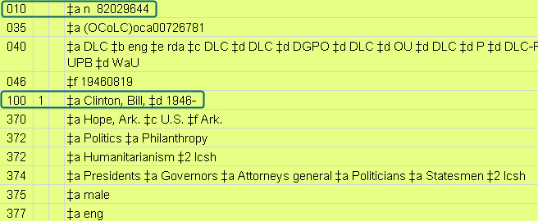
Bill Clinton
In this portion of the NAR, we see highlighted the 010 and the 100 which tells us the controlled “heading”
We also see the 046 field and some of the 37X fields which provide context for the entity
Notes:
102
Note in the 372 and 374 fields the optional citation and use of the lcsh form of the terms.
This is one of the few opportunities to view an 046 field, on which students are quizzed in the Comprehensive Exercises in Module 9. So briefly discuss the 046.
Q: Where does the 046 data come from?
A: 670 fields

Slide 103
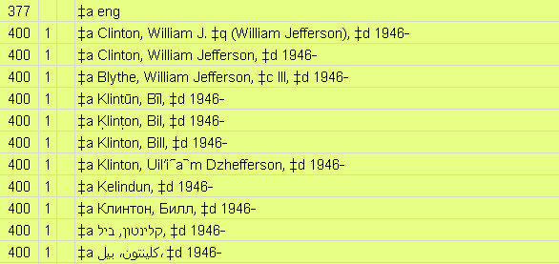
Bill Clinton (cont.)
… here, we see 400 ‘see-reference’ fields for variant forms not to be used in bibliographic access points
  These forms have appeared in resources
103
Notes:
103
103
Make the point that references reflect actual usage on resources being cataloged or in reference sources cited; they are not simply ‘made-up’ for any variant form the cataloger might anticipate.
Ideally, there should be a 670 field for each reference.

Slide 104
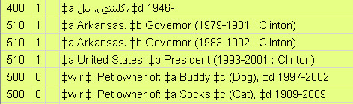
Bill Clinton (cont.)
… here, we see 500 ‘see-also reference’ fields for variant forms of the heading, which may be used in certain bibliographic access points
  Cataloging instructions specify which heading is correct
  This is an unusual situation specifically called for -- in this case, because Clinton was a ‘head of state’
104
Notes:
104
104
In other words…
“For some resources, the proper access point is the “Clinton” heading found in the 100
For other resources, the proper access point is the “Arkansas” or “United States” heading found in a 500”
Note also the additional – and optional -- 500 references which specify a relationship to another entity. Note the $w and $i subfields.

Slide 105
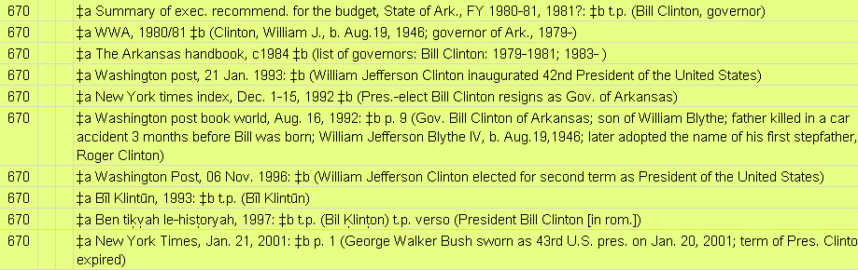
Bill Clinton (cont.)
… here, we see some of the 670 fields which document the sources in which forms of the heading (and information about the entity) have been found
Bonus: Why do you think the controlled heading uses the first name “Bill”, rather than “William”?
105
Notes:
105
105
Make the point that 670s are in the order in which they are consulted – so the first 670 is for the first work that was cataloged, requiring the ‘establishment’ of the heading and creation of the NAR.
Note -- as we see here in great detail – that the 670 fields can sometimes constitute a mini-biography. However, catalogers should resist this urge and strive for conciseness, emphasizing data sufficient to ‘contextualize’ the entity and ‘justify’ the forms of the heading and references.
[Do not agonize over the bonus question on the slide – students have not yet studied RDA chapters 9-11. For now, you can simply make the point that usage by the author is an important factor in determining the form of the heading – and Clinton first (and repeatedly, although not exclusively) used “Bill”]

Slide 106
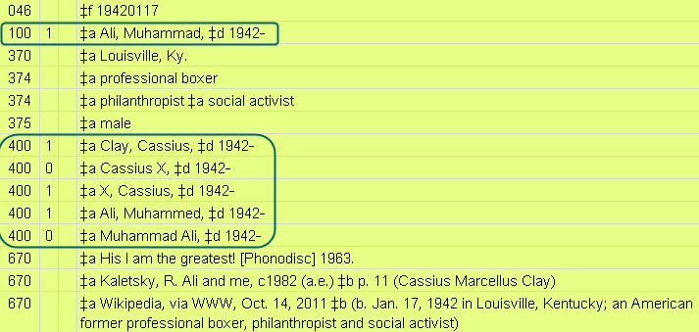
Muhammad Ali
Here, we see highlighted the 100 controlled form of the heading, and references from other forms which are not to be used in an access point
We also see the 046 coded data for date of birth, and 37X fields to help contextualize the entity
106
Notes:
106
106
Again, briefly discuss the 046.
Technically, the first letter of each data string in a 374 $a should be capitalized.

Slide 107
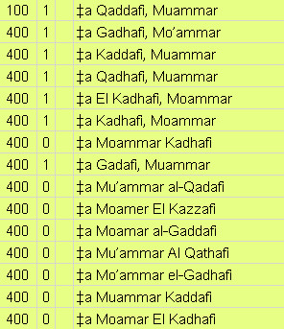
Muammar Qaddafi
Look at all these references from forms of the name not to be used in an access point!
  … and there are lots more!
Having these forms in the NAR will help point searchers from the ‘wrong’ form to the ‘correct’ form
107
Notes:
107
107

Slide 108
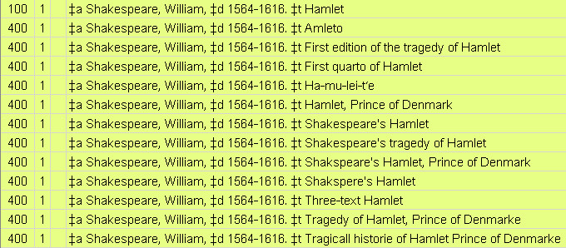
Shakespeare’s Hamlet
Even the title of a work has a controlled form – especially helpful for translations and variant titles
These references will point any searcher from the ‘wrong’ title to the ‘controlled’ title
108
Notes:
108
108
Bonus question:
Think of our module on Works, and how one chooses the preferred title: Why is the preferred title “Hamlet”, not one of the other variations? (in fact, this was not the original title)
[If you have the capability, display the NAR, and discuss briefly the 400s, 670s, and what “RETRO” means in the 952 (“This identifies records originally created as part of the retrospective project to convert manual LC authority cards to machine-readable form. The records may not contain all notes and references found on the original 3x5 cards” – DCM Z1)]

Slide 109
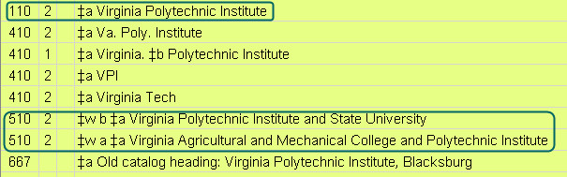
Virginia Tech
When persons change names, the heading is changed (e.g., Muhammad Ali).
When corporate bodies change names, multiple headings are used, and separate NARs are created for each period of usage
In 510 references, $w indicates ‘later’ or ‘earlier’
109
Notes:
109
109
This NAR is for the ‘middle’ name (chronologically) among three different names used in the LC catalog.
$w b = later
$w a = earlier

Slide 110
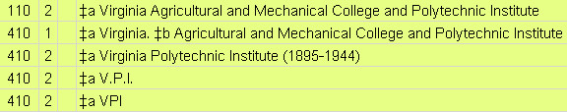
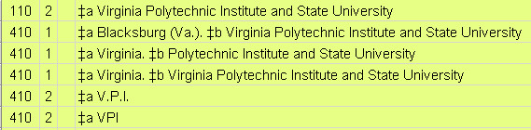
Virginia Tech
‘reciprocal’ NARs exist for the earlier/later headings
  Each NAR has the appropriate 510 references (not shown here)
110
Notes:
110
110
Here we see a difference between persons and corporate bodies – the creation of ‘reciprocal’ NARs.
Top record = earliest heading/first NAR
Bottom record = latest heading/last NAR
[Note: there is no NAR created for the very earliest form used (Virginia Agricultural and Mechanical College – see the 670 on the following slide), because it never needed to be used as a heading on bibliographic records]

Slide 111
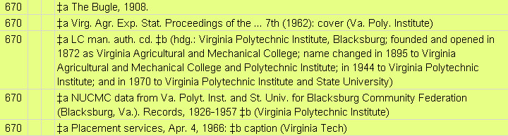
Virginia Tech
… the 670 fields provide information about the history of the names of this body
The dates cited in 670 fields can be used to determine the form to be used in an access point on a specific bibliographic resource
111
Notes:
111
111
[discuss extemporaneously the content of the various 670 fields]

Slide 112
Unit 4: The Broader Application of Authority Control
Controlled Terms, Codes, and Relationship Designators in RDA
Subjects
  The principle of Authority Control, as applied in these contexts, is similar to the context of Name Authorities: the intent is to facilitate more effective human and machine retrieval and manipulation through the use of controlled vocabulary
112
Notes:
<click> to display ‘principle’ bullet
112

Slide 113
Controlled Terms, Codes, and Relationship Designators in RDA
Content type
Media type
Carrier type
Conventional collective titles (e.g., “Plays,” “Poems,” “Novels”)
Language terms and codes
Controlled terms in NAR 37X fields
  Authorized form for Associated places
  LCSH terms for Occupation/Field of activity
Relationship Designators
Notes:
e.g. (not an exhaustive list):
‘text’, not ‘words’; ‘volume,’ not ‘book’
‘Plays,’ not ‘dramas’
‘German,’ not ‘Deutsch’
‘pol,’ not ‘psh’

Slide 114
Subjects
What are you searching for?
  What is the specific term?
    Earthquakes
  What variant terms might you search for?
    Quakes
  What are broader terms?
    Earth movements
    Natural disasters
  What are narrower terms?
    Earthquake magnitude
  What are related terms?
    Seismology
You probably know of “the red books’’
Notes:
114
When applied to subjects, the point is the same: What are you searching for? What is the controlled term for that topic?
The records which document the controlled vocabulary for subjects are not generally referred to as “Authority Records”; they are called “Subject Headings”. But they serve the same purposes as “Authority Records”.
In addition to the printed ‘red books,’ an online tool exists for subject purposes, called Classification Web.

