Slide 1

Marva Feature Overview
27 Jan. 2025
Franz Osorio
fosorio@loc.gov

Slide 2
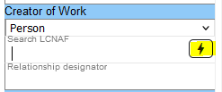
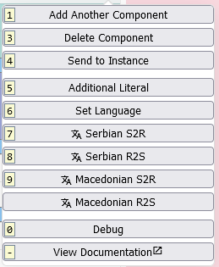
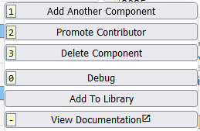
Action Button
Quick access to common tasks
Contextual
Preferred Title of the Work | Contributors
Notes:
-Adding/deleting a component
-Transliteration
-Access to documentation

Slide 3
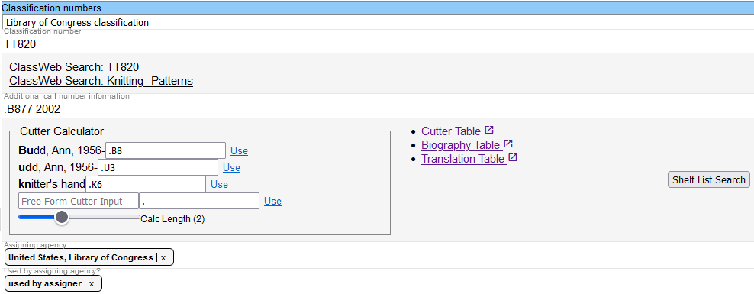
Classification Support - Cutter Calculator
Quick Cutter Generation
from Creator or title
Notes:
Links to Classweb
Editable links

Slide 4
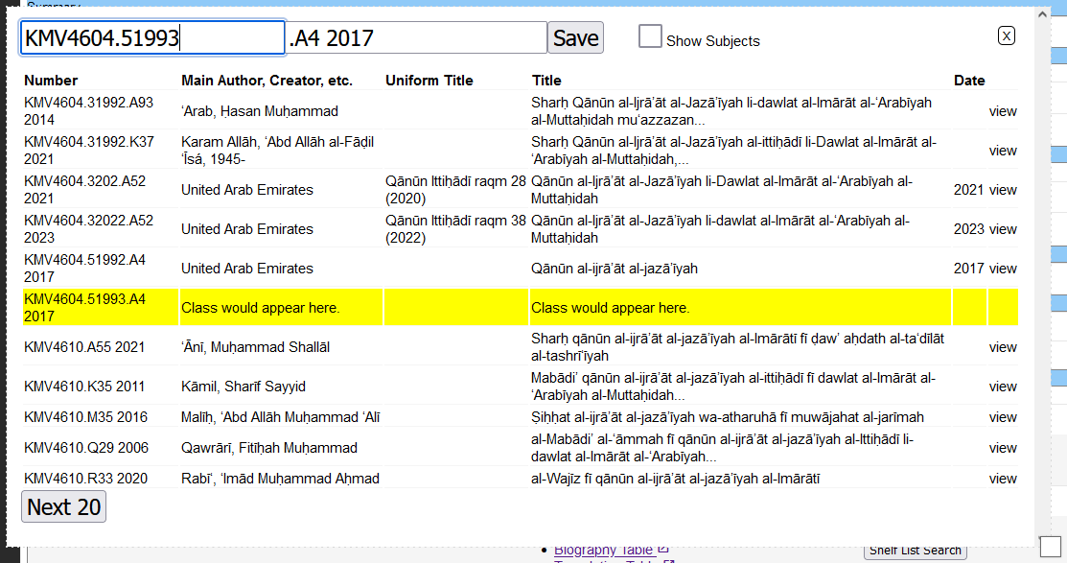
Classification Support - Shelflist Search
Show where the current Class Number
would fit on the shelf

Slide 5
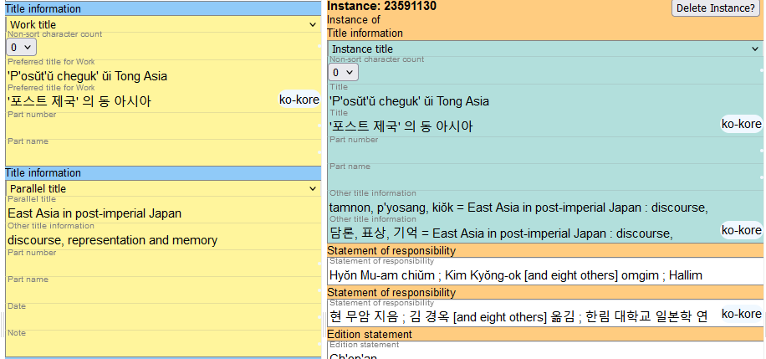
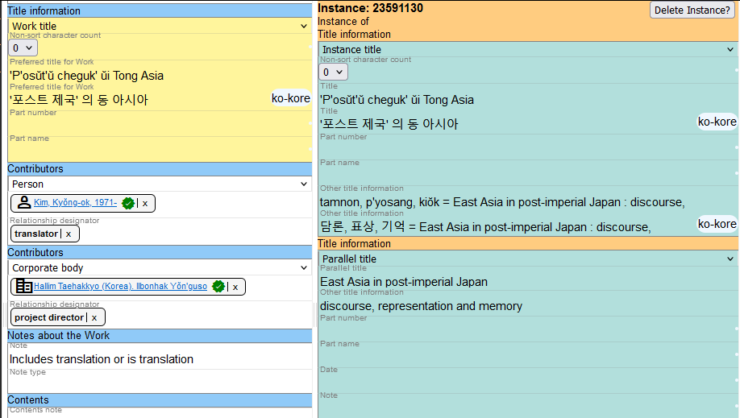
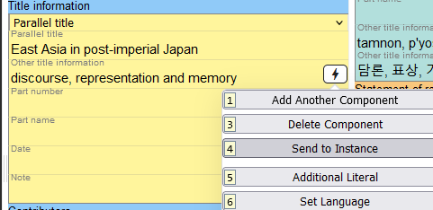
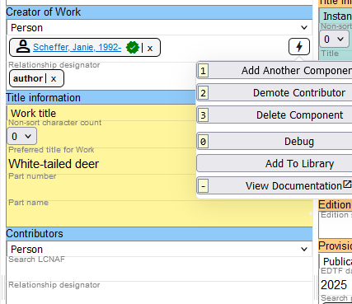
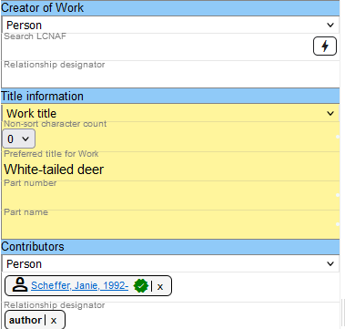
Saving Time
“Send to …”
  Move a title from a Work to an Instance
  >
  Demote Contributor
  >
Notes:
Copy&Paste
- Subjects

Slide 6
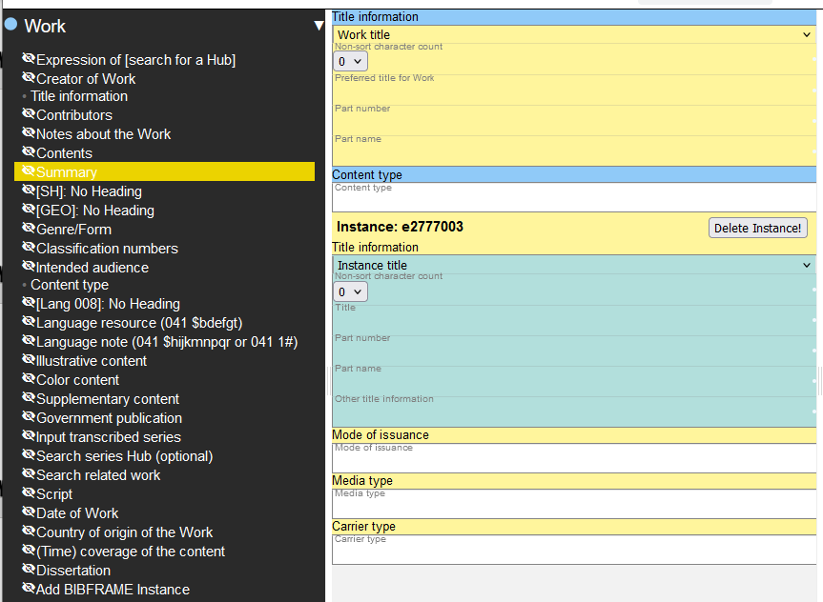
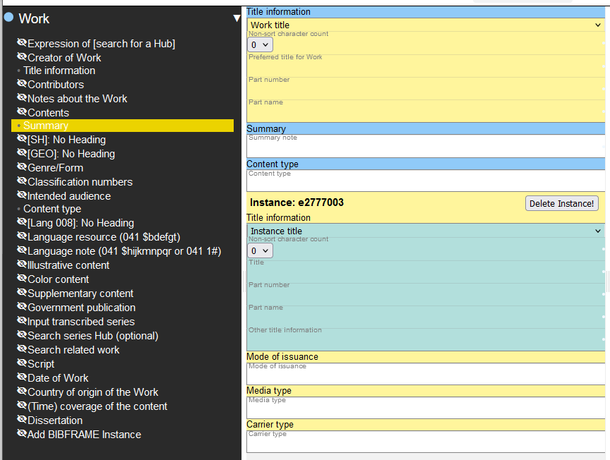
Ad Hoc Mode
Only populated or mandatory
components
  Work: ~30 > 2
Add components when
needed

Slide 7
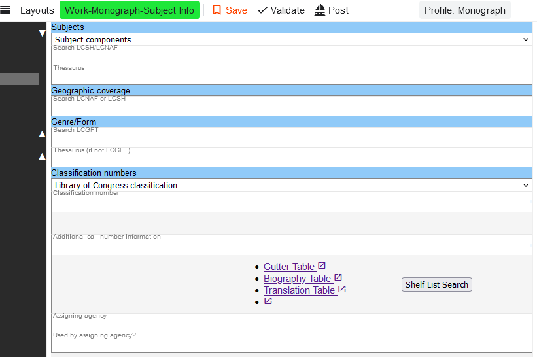
Custom Layouts
Another way to limit total components
User defined
Support for workflows
Notes:
“Government Publication”

Slide 8
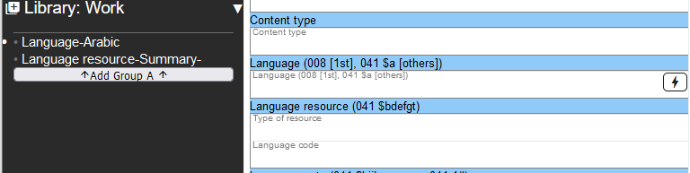
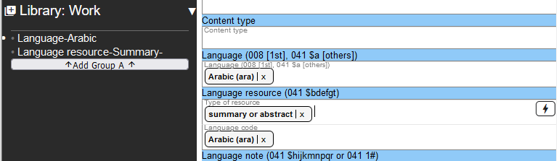
Component Library
Quickly add frequently used data
Group components
Notes:
Profile defaults

