Slide 1

Library of Congress January 2025 BIBFRAME Update Forum
Monday, January 27, 2025

Slide 2
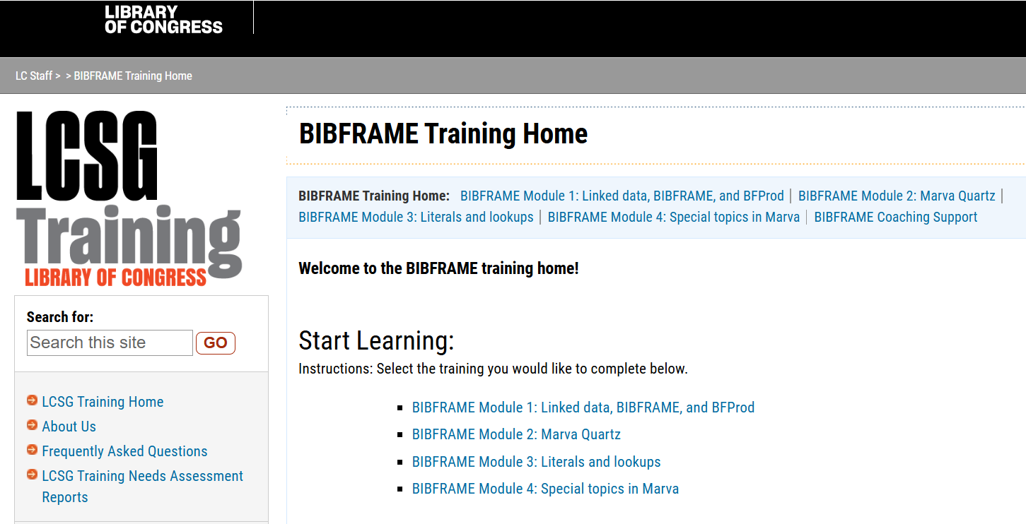
BFProd Staff training

Slide 3
Numbers and Timeline
Acquisitions and Bibliographic Access Directorate (ABA) has over 300 catalogers – “cataloging central”
  Including six overseas offices
Researcher & Collections Services (RCS) has catalogers working in special format areas
ABA target completion for BFProd training: March 31, 2025
LCAP (Library Collection Access Platform) training: April-May 2025

Slide 4
BIBFRAME and BFProd Vision
Library of Congress BIBFRAME initiative and community
Sharing BIBFRAME tools and BIBFRAME information, including training materials for BIBFRAME and linked data
Interim period where MARC is still relevant and required, but with a lot of give and take
The date for full linked data implementation is on the horizon

Slide 5
BFProd Training
Eleven cohorts of 20-25 participants
Training for each cohort is two weeks long
  Week 1: Asynchronous
  Week 2: Office Hours
Socialization
  Teams Chat
  Pioneer meetings
  Coaching support

Slide 6
Internal BFProd Training Materials
LCSG Training Site – 4 Modules for asynchronous learning
  Recorded tutorial (5 minutes)
  Knowledge Application Activity (KAA)
Coaching Support
Confluence Site
Teams Chat

Slide 7
External BFProd Training Materials
Catalogers Learning Workshop BFProd site
Marva Guidance Sheets
  Marva View Documentation
  Example: Creator of Work

Slide 8
Thank you!

