Slide 1

Modern MARC
Library of Congress BIBFRAME Update Forum
January 27, 2025
Jodi Williamschen
Network Development & MARC Standards Office

Slide 2
What is Modern MARC?
RDA alignment
More URIs
Less data duplication
Less coded data
Library-generated Modern MARC records began appearing in the library’s data in September 2024
Learn more: https://www.loc.gov/marc/ModernMARC-Jan2025.pdf

Slide 3
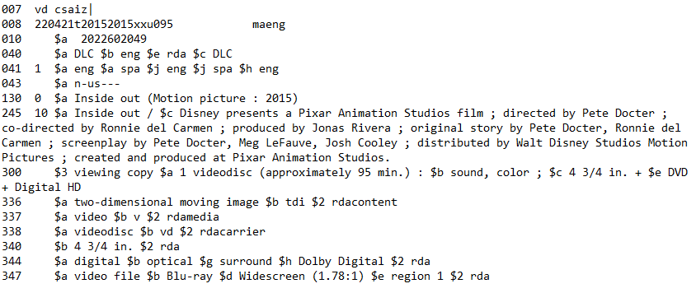

Current MARC

Slide 4
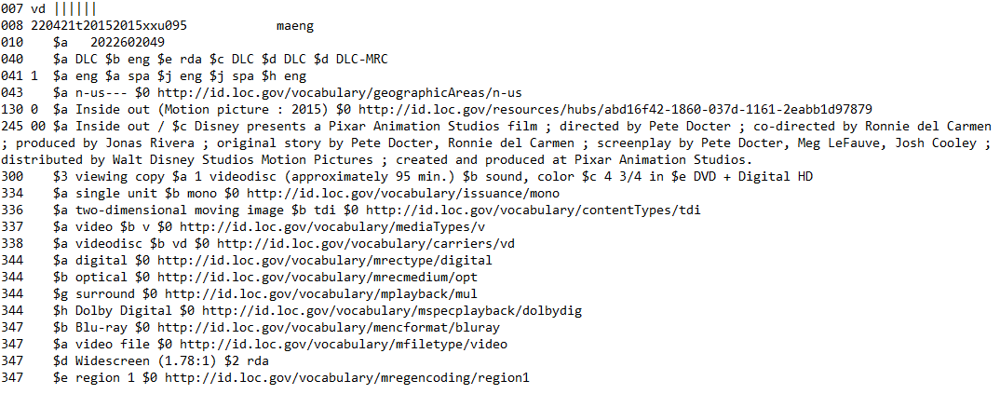

Modern MARC

Slide 5
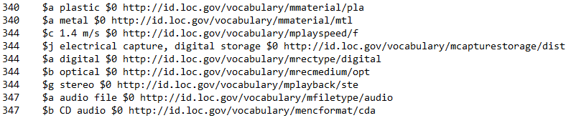
RDA alignment
More 34X fields
  There are separate 34X fields for each element because the source vocabulary URI is different for each element

Slide 6
RDA alignment
334 field – Mode of Issuance
758 field – Resource Identifier

Slide 7
RDA alignment
264 field(s) instead of a single 260 field

Slide 8
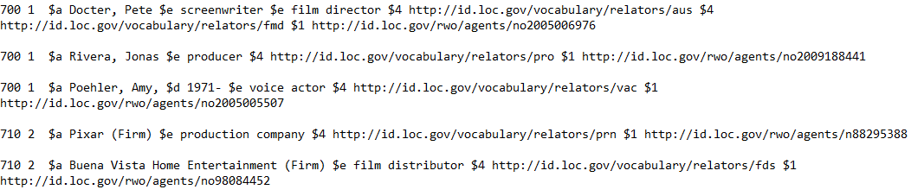
More URIs
Expanded use of URIs in authorized access points

Slide 9
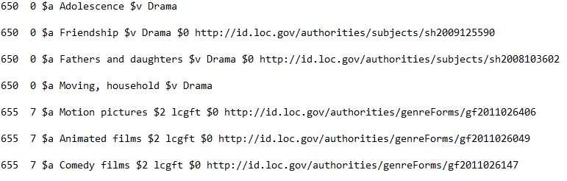
More URIs
Topic, genre URIs

Slide 10
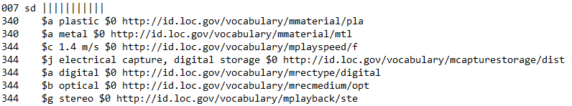
Less data duplication and coded data
Data elements that now appear in 007 and 34X fields will only appear once

Slide 11
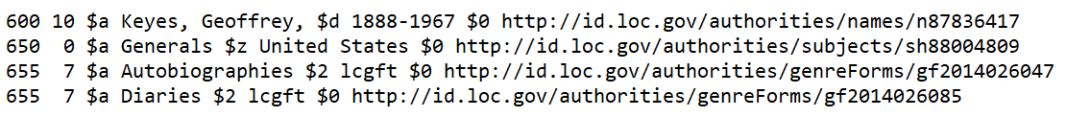


Less data duplication
Fewer genre/form subdivisions, more 655 fields, and more URIs

Slide 12
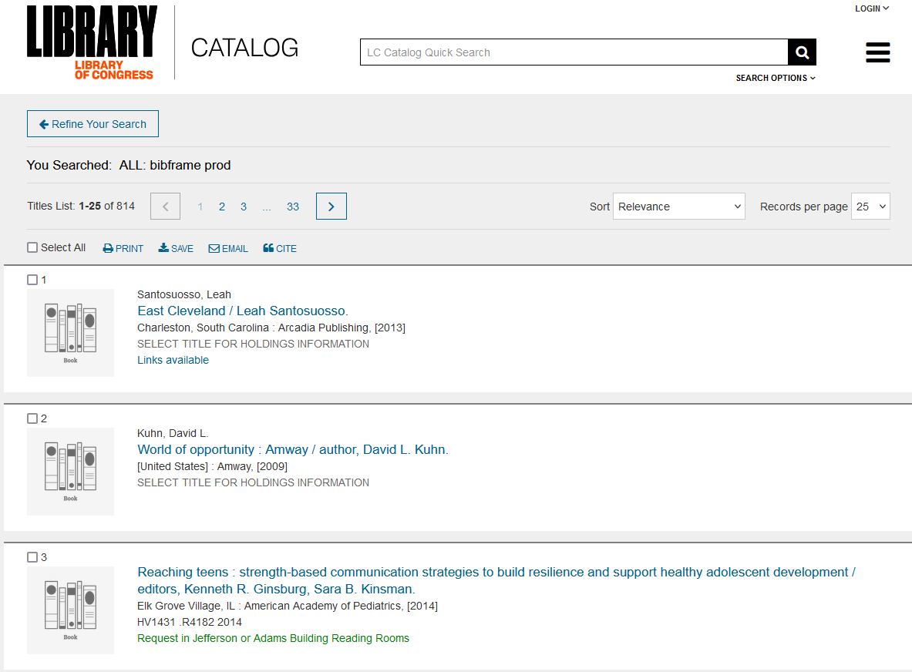
See Modern MARC records
https://catalog.loc.gov/
Search “bibframe prod”

